Slide 1
Weekly Meeting
Feb 23, 2022
Gwangwoo Kim

Slide 2
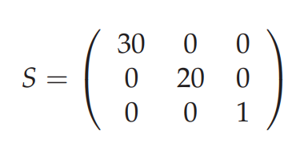
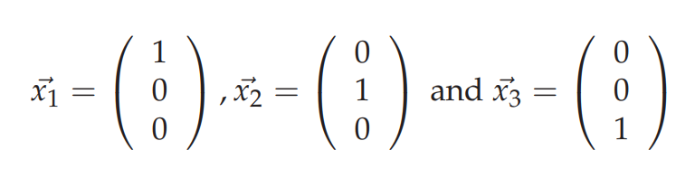
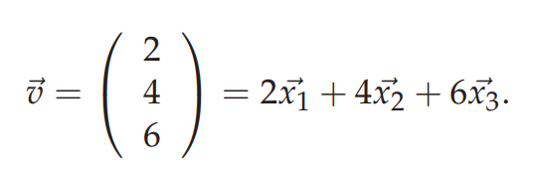
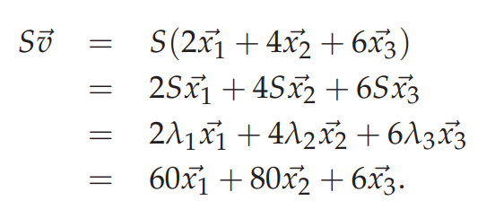
18.1 Linear algebra review
eigenvectors

Slide 3
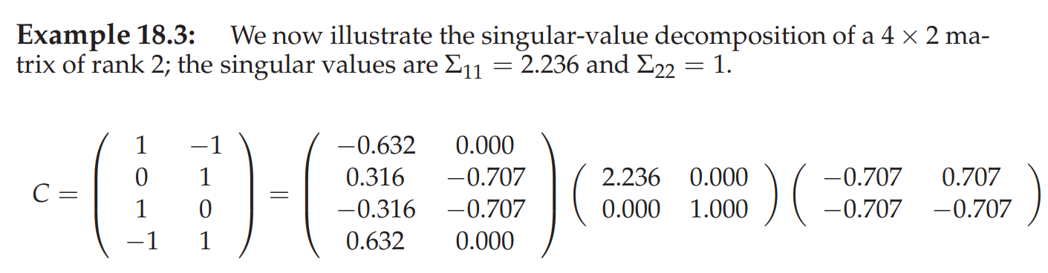
18.2 Term-document matrices and singular value decompositions
truncated SVD

Slide 4
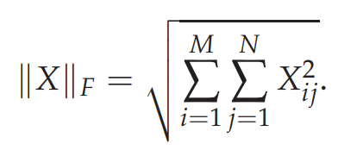
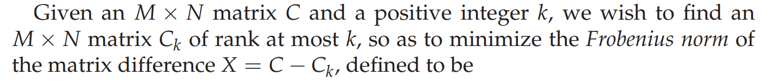
18.3 Low-rank approximations
Definition (Frobenius norm): Given a matrix X, we define the norm of matrix as
<Note> If rank(C)<=k, the estimation is clearly itself.
When k<rank(C), we refer to the estimation as a low-rank approximation.

Slide 5
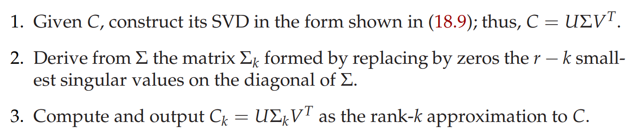
18.3 Low-rank approximations

Slide 6
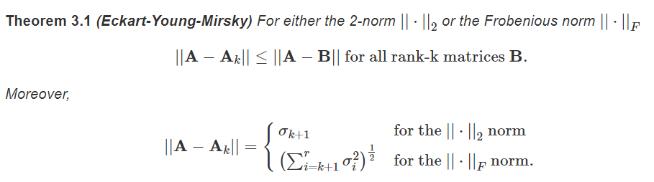
18.3 Low-rank approximations

Slide 7
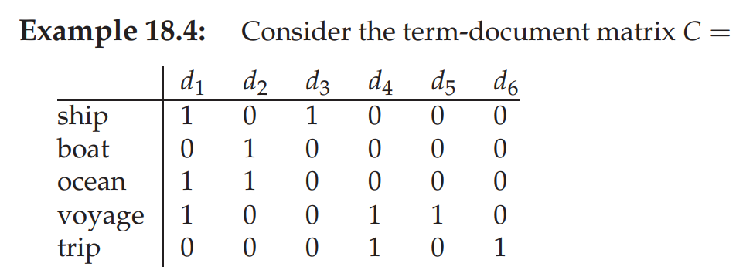
18.4 Latent semantic indexing

Slide 8
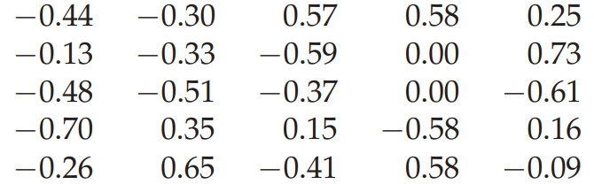
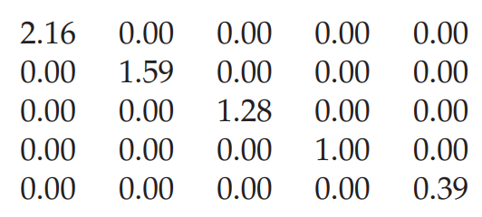
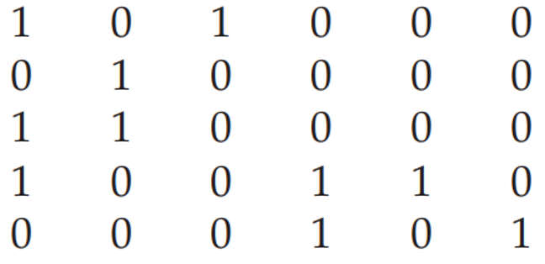
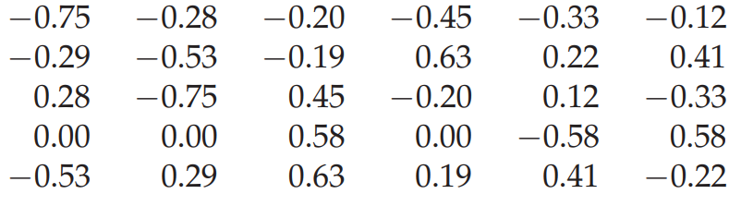
18.4 Latent semantic indexing
U (term matrix)
Sigma
V^T (doc matrix)

Slide 9
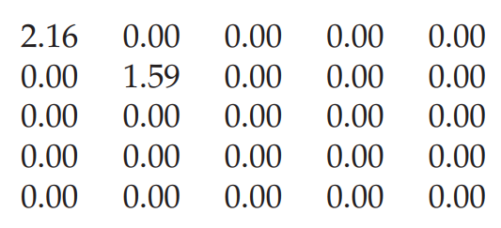
18.4 Latent semantic indexing
U (term matrix)
Sigma
replacing by zeros
V^T (doc matrix)

Slide 10
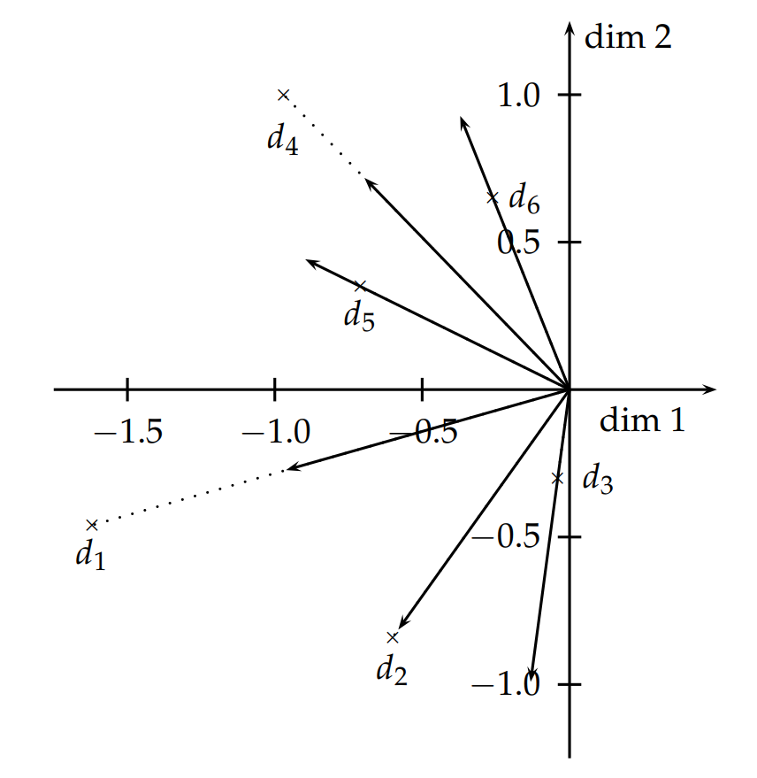
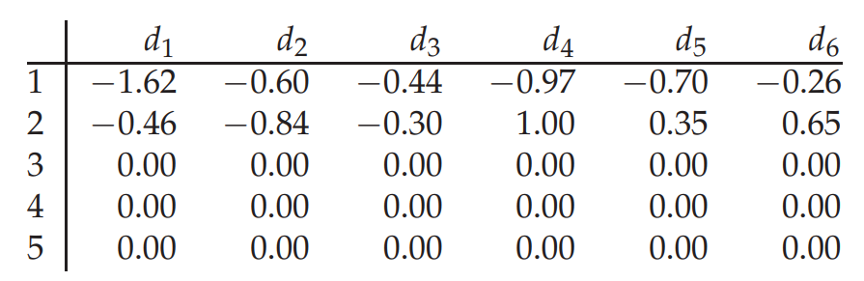

18.4 Latent semantic indexing

Slide 11
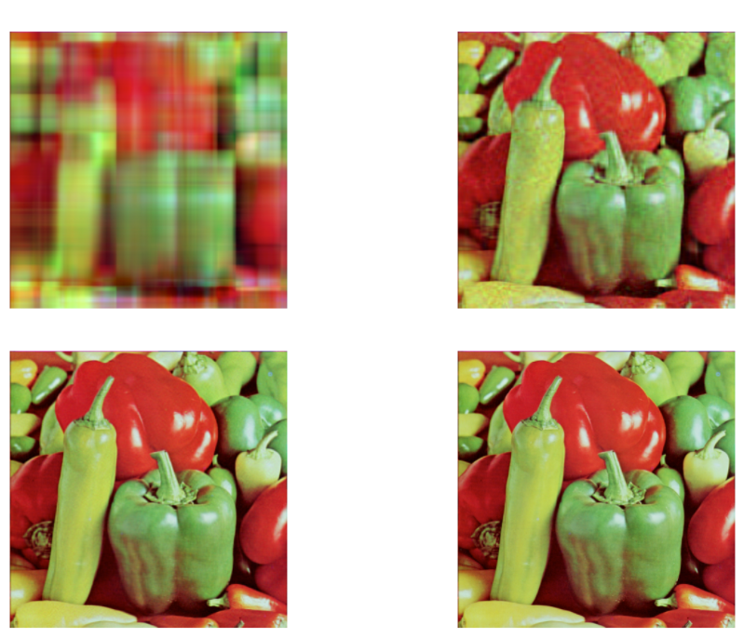

18.4 Latent semantic indexing
K=3
K=30
(3,512,512)
K=100
K=300

Slide 12
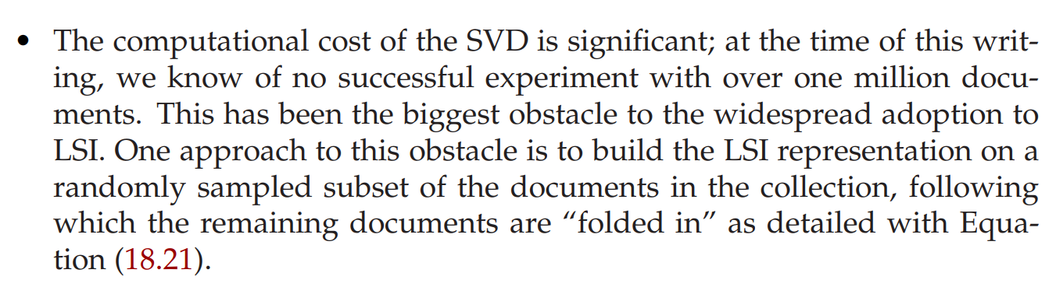
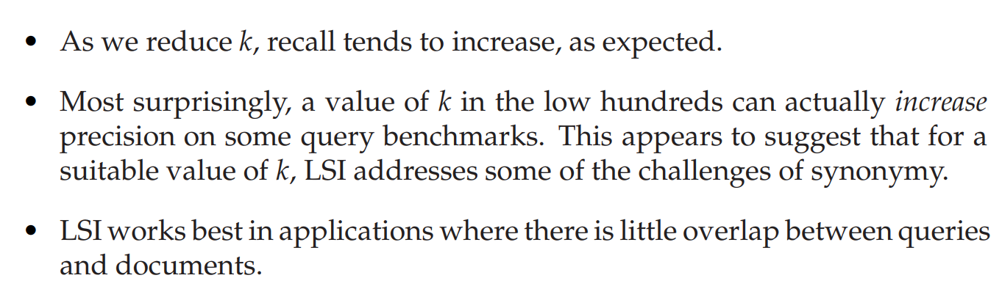
18.4 Latent semantic indexing
<Note> there is no good way of expressing negations (find documents that contain german but not shepherd),

